Slide 1



Sales Exploration
View in Power BI
Last data refresh:
3/19/2022 5:06:57 AM UTC
Downloaded at:
4/6/2022 4:29:22 PM UTC

Slide 2
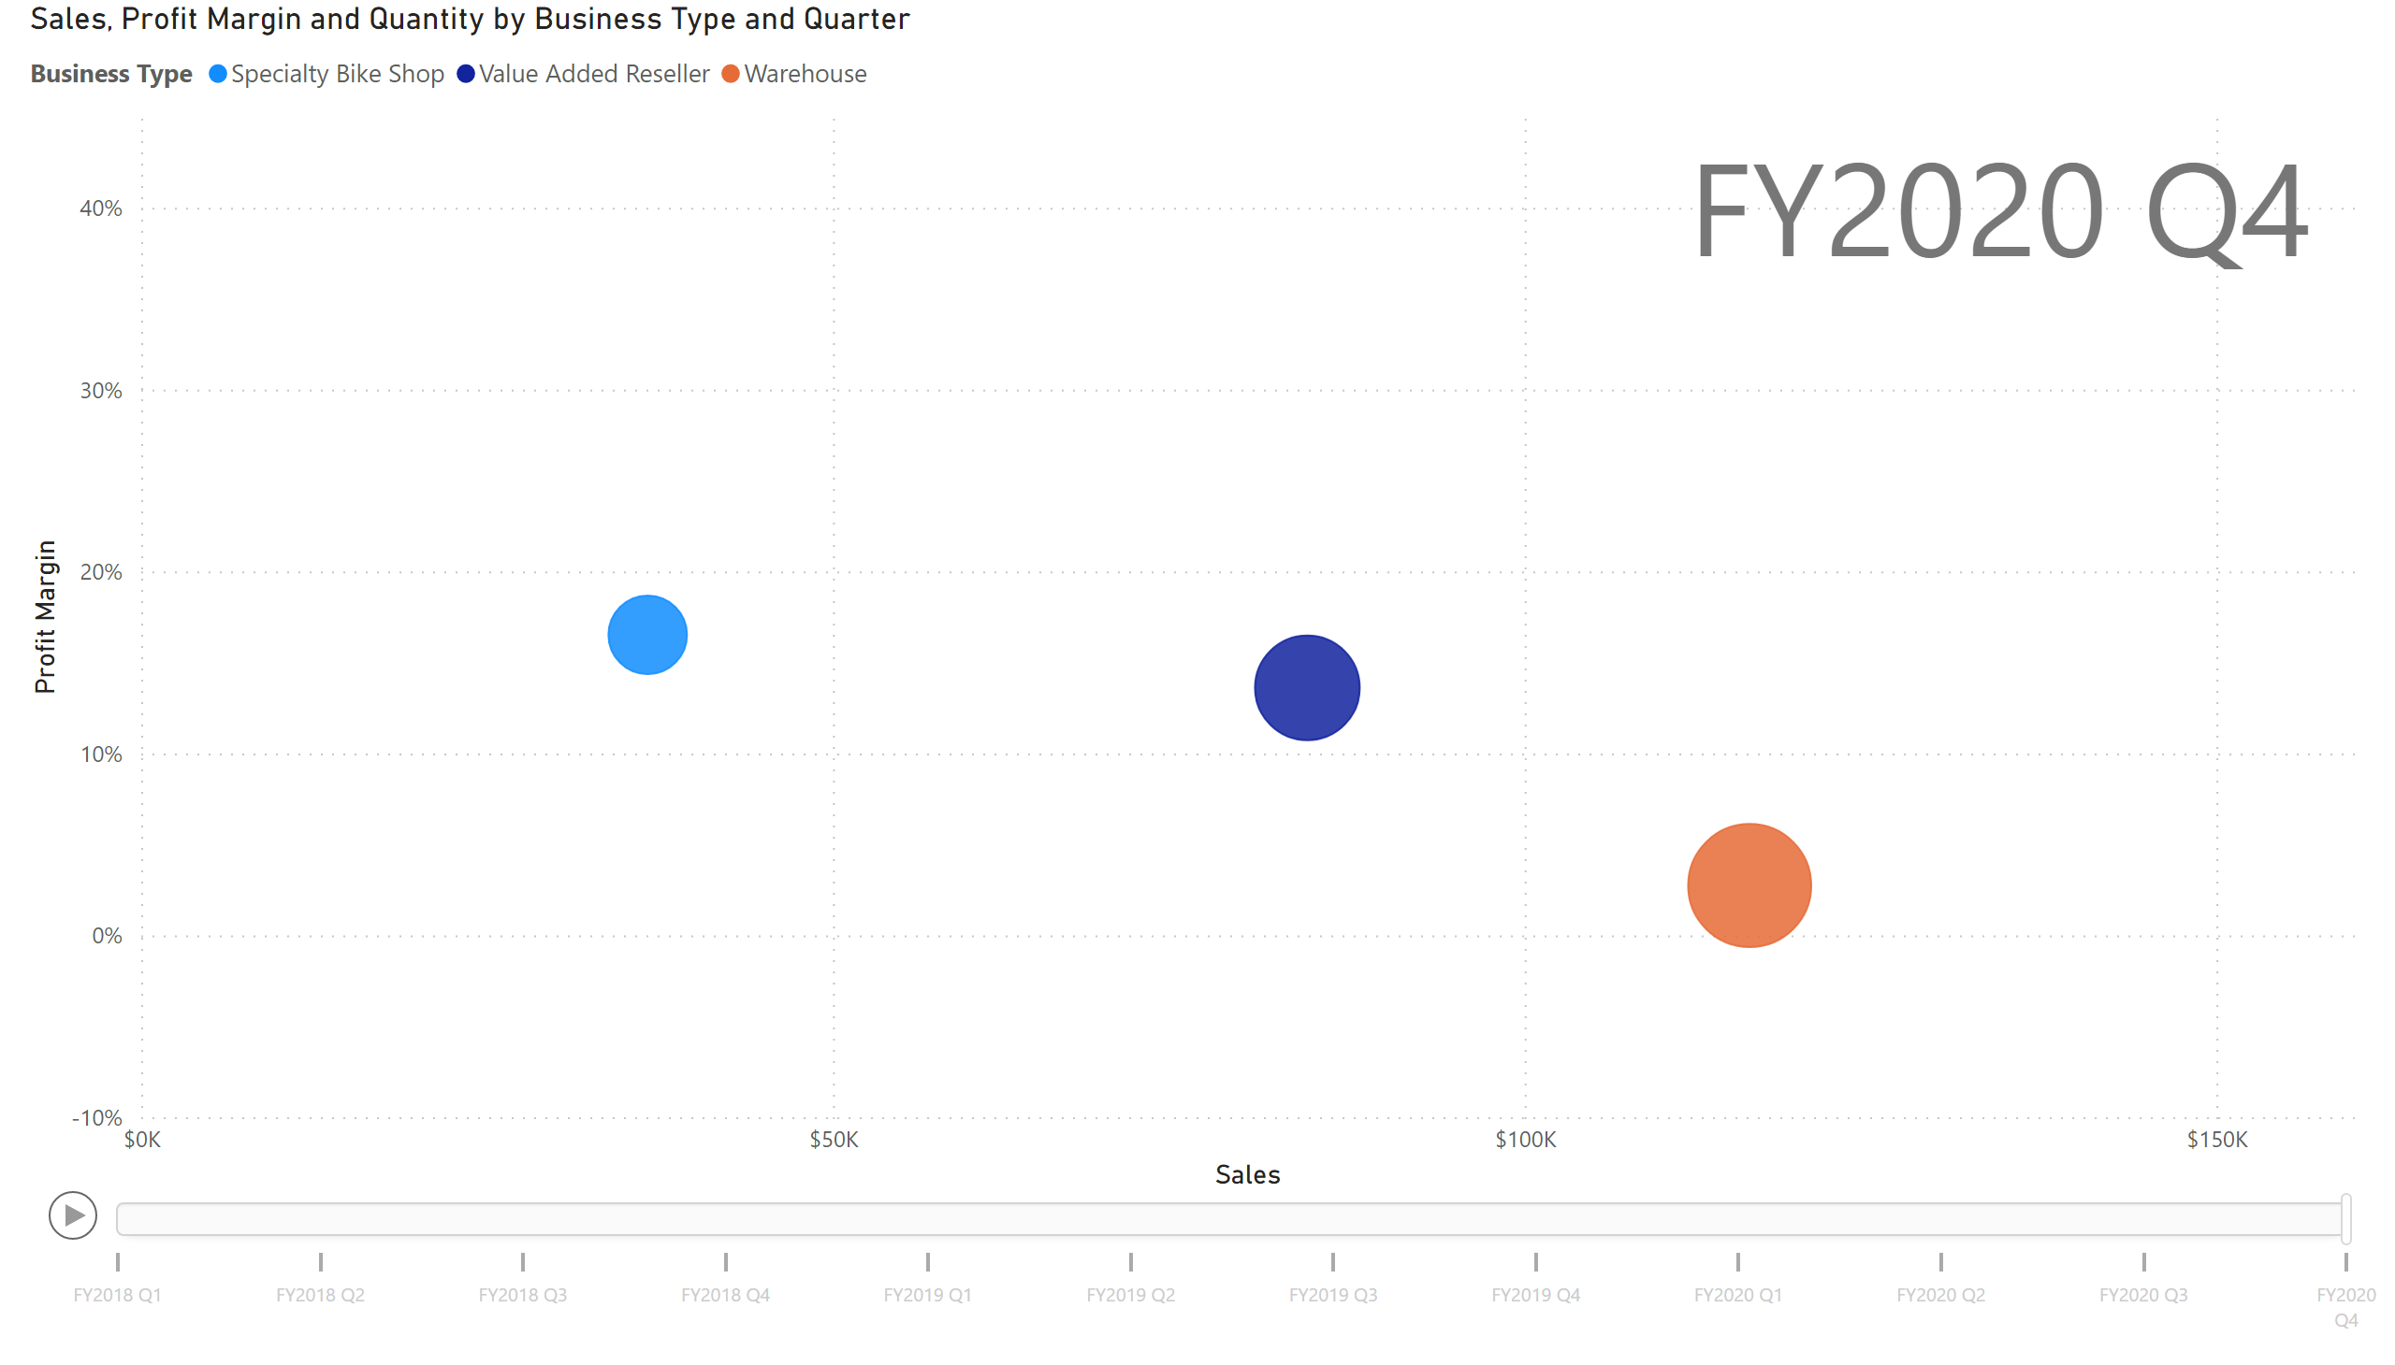
Scatter Chart
Notes:
scatterChart
No alt text provided

Slide 3
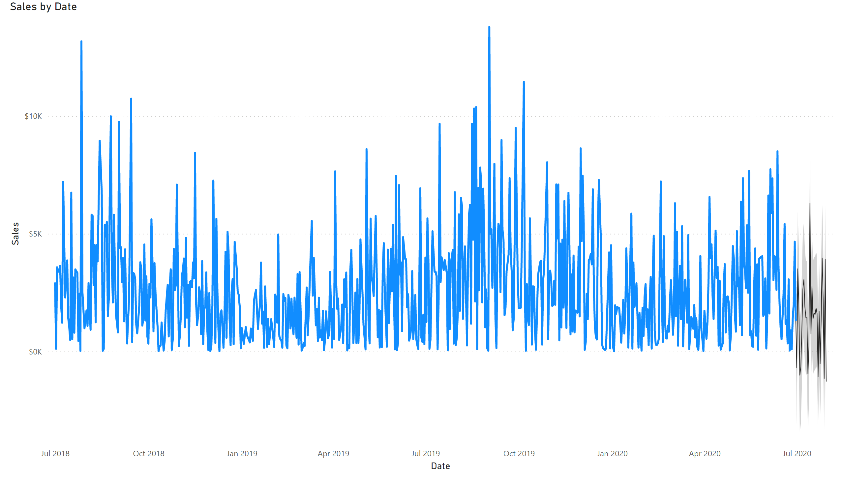
Forecast
Notes:
lineChart
No alt text provided

Slide 4
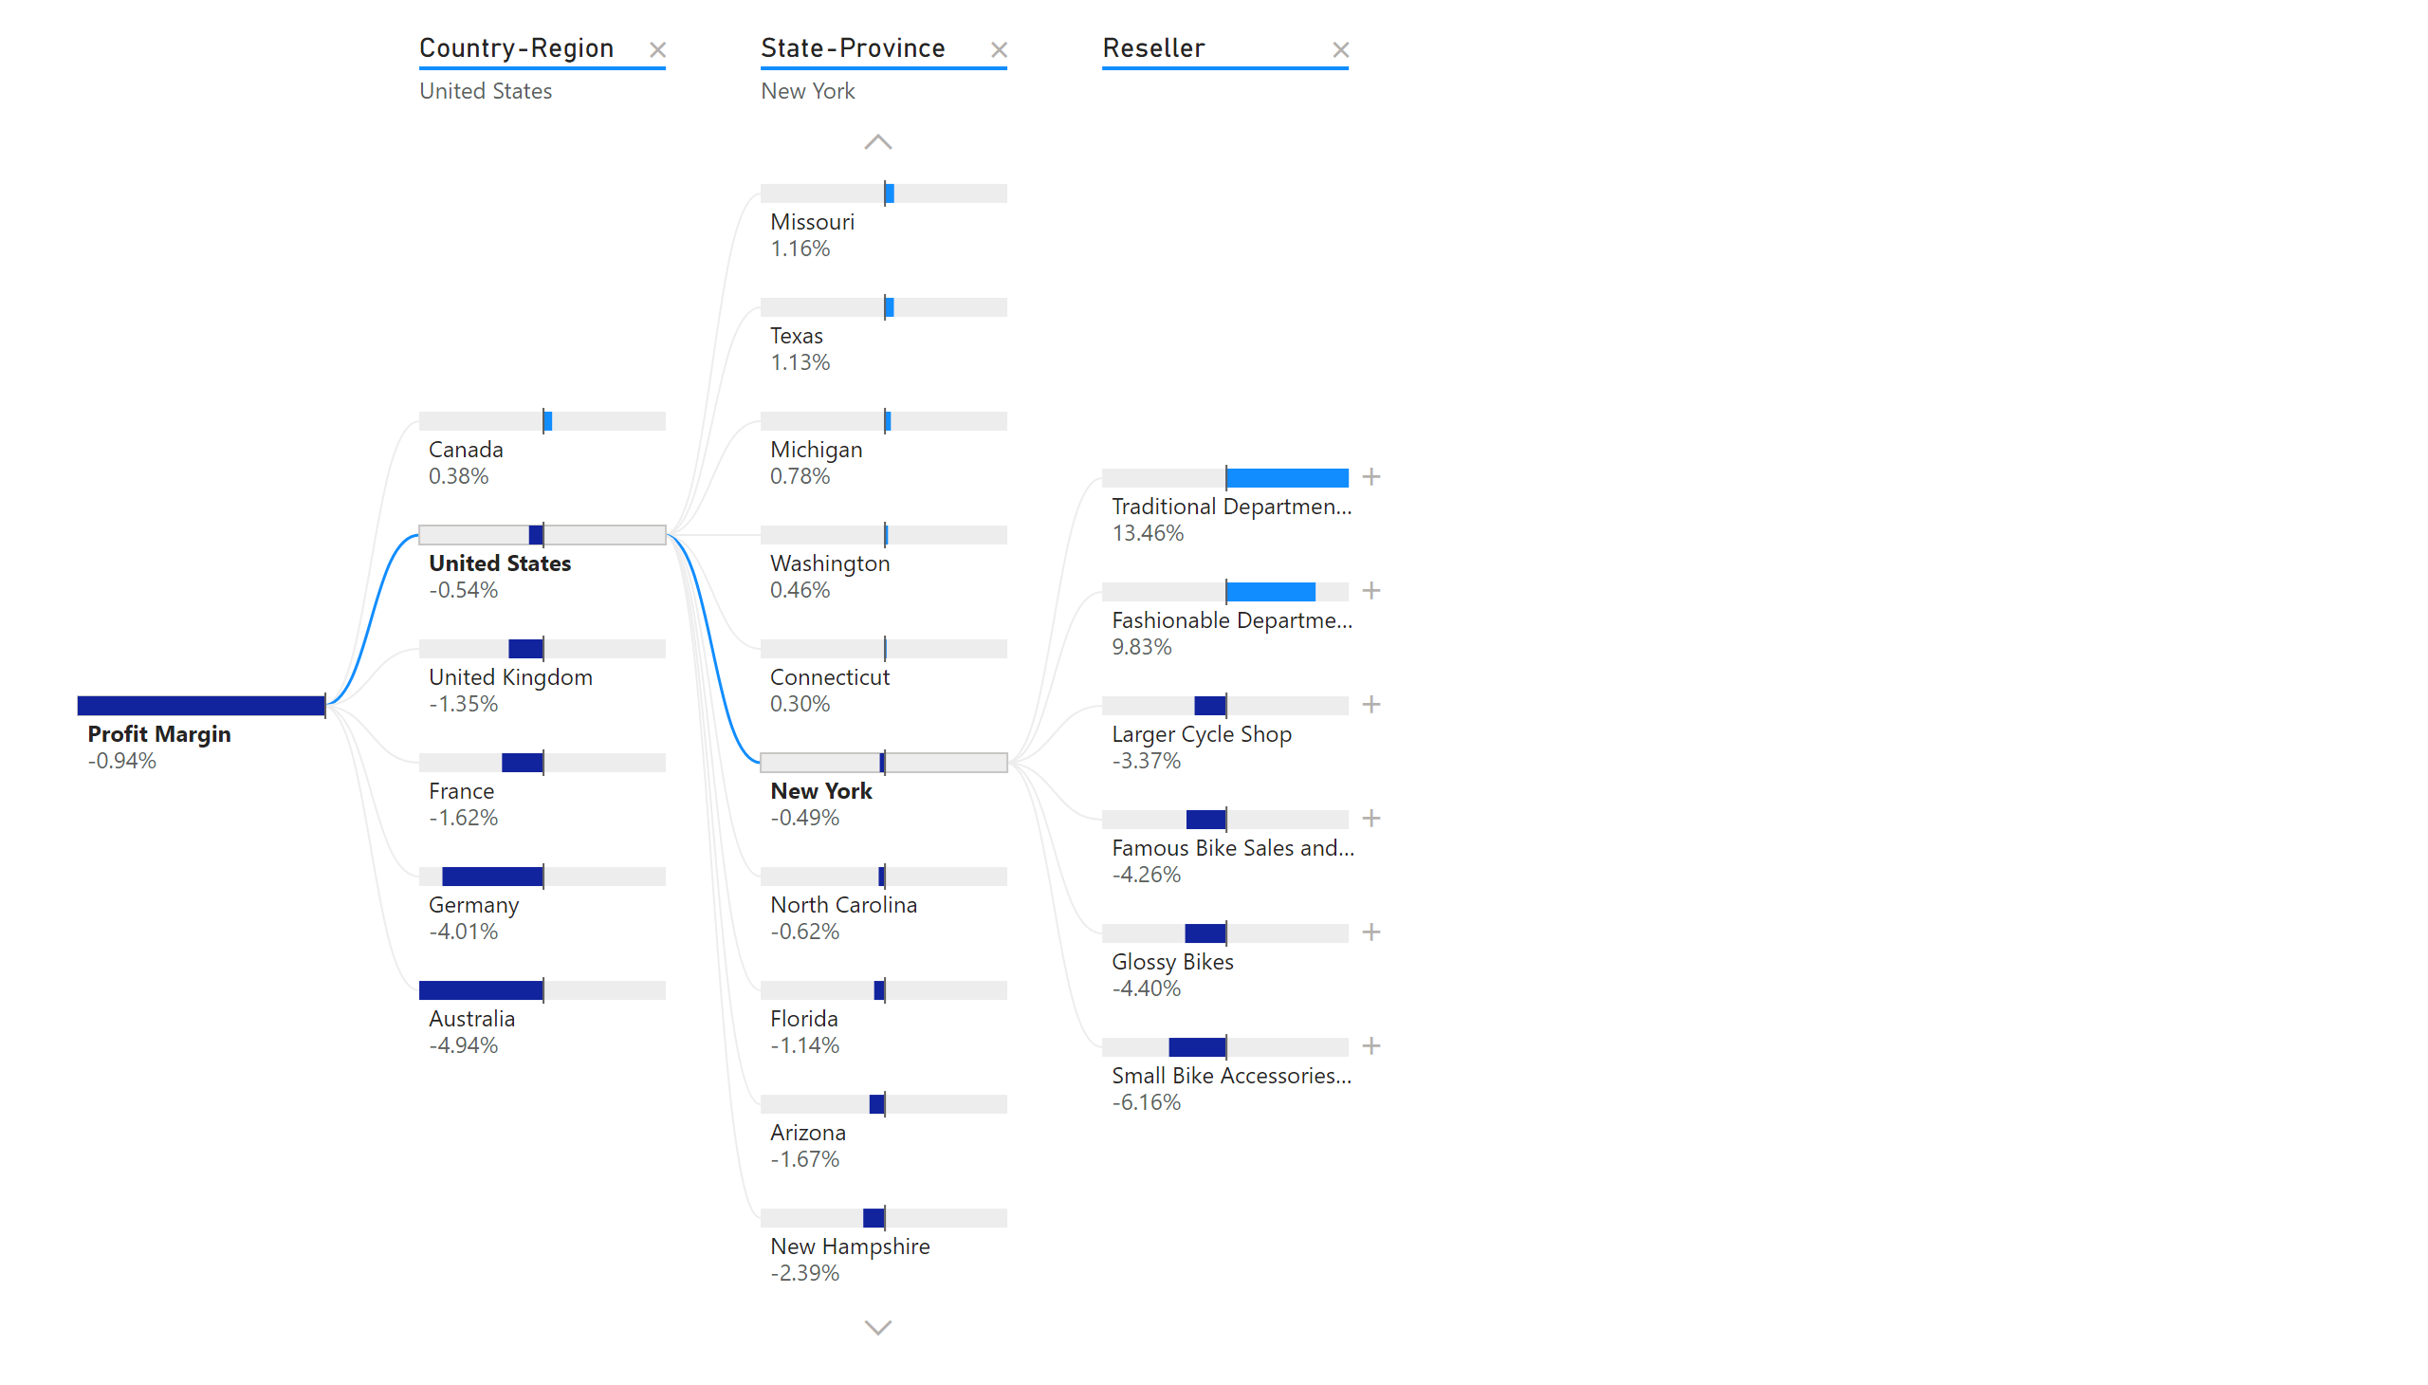
Decomposition Tree
Notes:
decompositionTreeVisual
No alt text provided

Slide 5
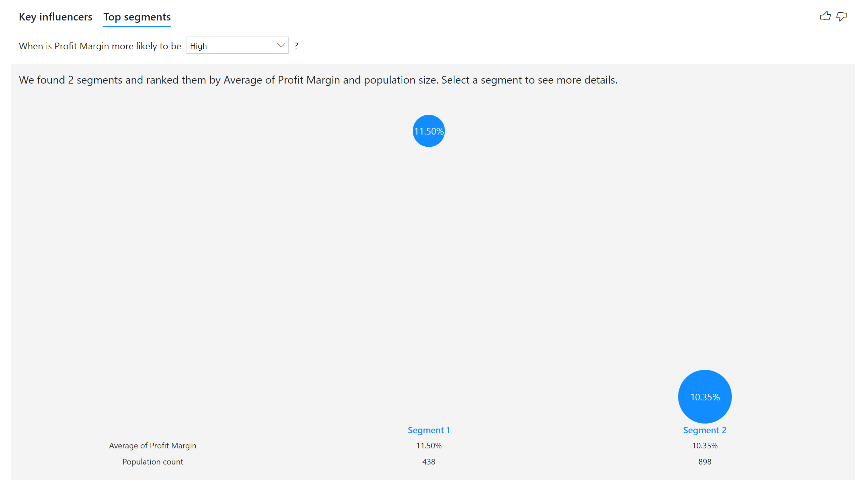
Key Influencers
Notes:
keyDriversVisual
No alt text provided

